Slide 1
Intermediate Coding Week 16
Recursion + Finishing up Quick Sort
Notes:
Recursion can seem difficult at first, but it’s actually pretty simple.
It’s very powerful.

Slide 2

Quick Sort
Notes:
Shopping basket was the best icon I could find for “sorting”… might not be the most appropriate.

Slide 3
Quicksort
quicksort: Repeatedly picks an element, partitions the remaining elements into two-subarrays depending on whether they are less than or greater than the pivot, and sorts the subarrays recursively.
Like merge sort, quicksort is a divide-and-conquer algorithm.
This is the sorting algorithm most computers use (Arrays.sort(arr))
The algorithm:
Randomly pick an element (called the pivot).
Swap the elements so that all the elements to the left of the pivot are less than the pivot and all the elements of the right of the pivot are larger than the pivot (called a partition).
Recursively perform quicksort on the subarray to the left of the pivot and the subarray to the right of the pivot.

Slide 4
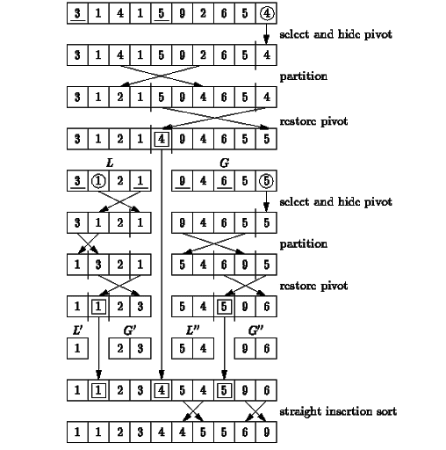
Quicksort example

Slide 5
Quicksort video (dances)!
https://www.youtube.com/watch?v=ywWBy6J5gz8

Slide 6
15 Sorting Algorithms Compared Video
https://www.youtube.com/watch?v=kPRA0W1kECg

Slide 7

Recursion, Explained

Slide 8
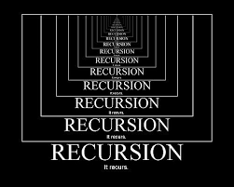
What is recursion?
Recursion is a method of programming that involves splitting up a large and possibly complex task into simpler and smaller versions of itself.
Generally, this takes the form of a method calling itself.
Think about it like this sentence:
“Read this sentence and do what it says twice.”
Notes:
Most recursive solutions can be implemented iteratively, but it can be a nightmare.

Slide 9
How to do recursion
As you saw in that sentence example, recursion can easily get stuck in infinite loops.
We prevent this from happening by having at least 2 cases in every recursive problem:
base case: a simple occurrence that can be answered directly.
recursive case: a more complex occurrence of the problem that cannot be directly answered, but can instead be described in terms of smaller occurrences of the same problem.
Notes:
You can have multiple base cases or recursive cases but you have to have more than one of each.
If you only have base cases it’s not recursive. If you only have recursive cases you’ll get stuck in a loop.
Remember, recursion calls itself.

Slide 10
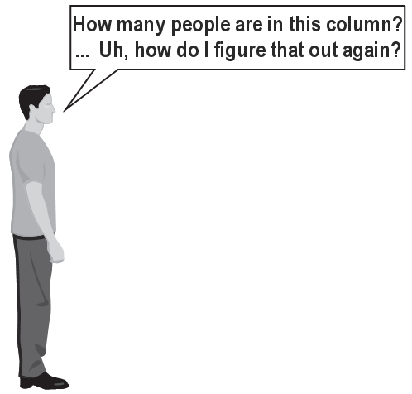
Recursion example
You’re standing in line and you want to know how many people are in front of you.
You can’t see the start of the line from where you’re standing, so you can’t just count the people.
But you can ask the person in front of you to help you out.

Slide 11
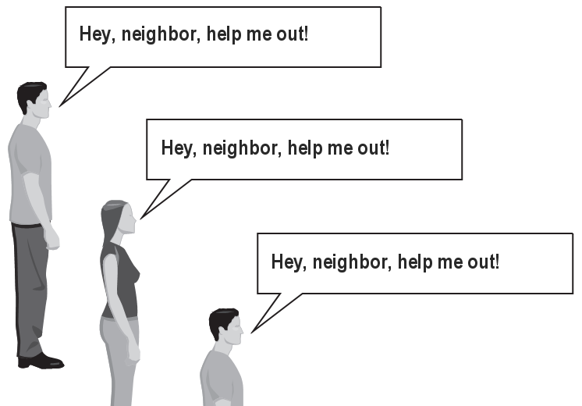
Recursion example continued
In this case, a good idea might be to ask the person in front of you how many people are in front of him/her.
Then, your neighbor will ask the person in front of them, and so on.
The base case is the person at the front of the line who doesn’t have anyone in front of them. They will return 0.
The recursive case is everyone else. They ask the person in front of them, and if that person responds with N, they answer N + 1.

Slide 12
Recursion example code
public static int peopleInFront(/* parameters here */) {
if (frontOfLine()) { // BASE CASE
return 0;
}
// RECURSIVE CASE
return peopleInFront(/* parameters of person in front here */) + 1;
}

Slide 13
Recursion video
Home Alone, anyone?
https://www.youtube.com/watch?v=hZ9q3PtiYu8
Notes:
I know it’s not Christmas, but Home Alone anyone?
Context: Kevin is supposed to be on vacation with his big family in Florida, but he gets on the wrong plane. His family didn’t notice until they try to passhim his bag. There are so many people in his family that giving him the bag is like recursion!
What was the base case? What was the recursive case?

Slide 14
Fibonacci Sequence
A classic example of recursion is the Fibonacci sequence, where each number in the Fibonacci sequence is the sum of the previous two numbers, and the first two numbers are both 1.
So the Fibonacci Sequence goes: 1, 1, 2, 3, 5, 8, 13, 21, ….

Slide 15
Lucas Numbers
The Lucas numbers are a sequence that is very similar to the Fibonacci sequence, but the first two numbers are 2 and 1 instead of 0 and 1.
In other words, each Lucas number is the sum of the previous two Lucas numbers, and the first and second Lucas numbers are 2 and 1.
The first few Lucas numbers are 2, 1, 3, 4, 7, 11, 18, 29, …

Slide 16

Problems

Slide 17
Question 1
Write a recursive method printBinary that accepts an integer and prints that number's representation in binary (base 2).
Example: printBinary(7) prints 111
Example: printBinary(12) prints 1100
Example: printBinary(42) prints 101010
Write the method recursively and without using any loops.

Slide 18
Question 2
Write a recursive method pow that accepts an integer base and exponent and returns the base raised to that exponent.
Example: pow(3, 4) returns 81
Solve the problem recursively and without using loops.
Bonus! Notice the following mathematical property:
3¹² = 531441 = 9⁶
= (3²)⁶
531441 = (9²)³
= ((3²)²)³
Can you make the recursion even more efficient by using this trick?

Slide 19
Question 3
Write a program that finds the factorial of a number.
If you don’t know what a factorial is, it is the product of all positive integers less than or equal to a specific number, down to 1. The factorial is denoted by a ! symbol.
For example, 3! = 3 * 2 * 1 = 6 and 5! = 5 * 4 * 3 * 2 * 1 = 120.
Factorials get very big very quickly, so you will have to test this on relatively small numbers (less than 13).

Slide 20
Question 4
We have already seen an iterative implementation of binary search. But binary search can be implemented with recursion, too!
Implement binary search using recursion.
If you’re stuck, think about what the base case and the recursive case could be!

Slide 21
Bonus Question 5
Can you write solutions for Questions 1 and 2 using only iterative loops and no recursion?

